Slide 1
+
Institute of Software Technology
Predicting and Learning the Performance of Configurable Systems
Seminar Advanced Software Engineering
27.06.2019

Slide 2
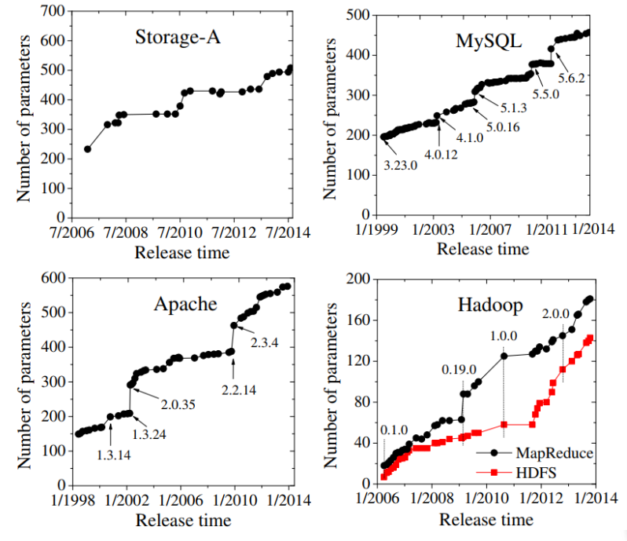

Motivation: More Configurations appear
Programs are getting more and more configuration options.
Notes:
Todays programs are getting more configurable
apache… filter configuration, number of threads , thread spawning
Good for stakeholders and customers
Enables tailoring for specific requirements

Slide 3
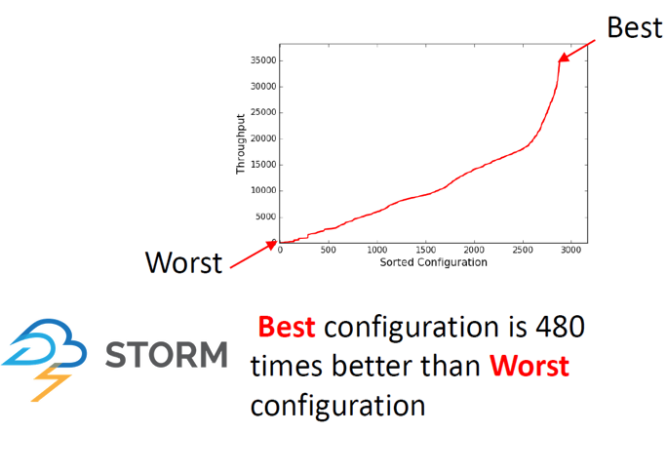
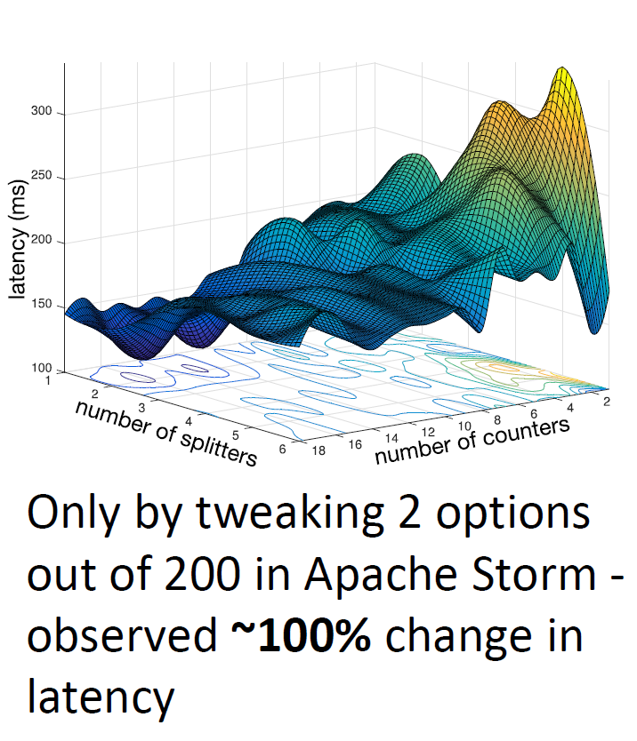
Motivation: Configurations matter!
But: Bad configurations can have a big impact on performance:
More Configurations
More Possibilities of Performance Influences
Performance prediction is hard.
Notes:
Greate performance diffrences between configurations of the same system.
Change of 1 option can make a huge difference
-> hard to predict

Slide 4

Motivation: Configurations matter!
(Near) Optimal configurations
Good default configurations
Implementation problems
Proof of a good average performance
We are looking for:
Can’t we just measure every configuration?
Notes:
Why should we care?

Slide 5

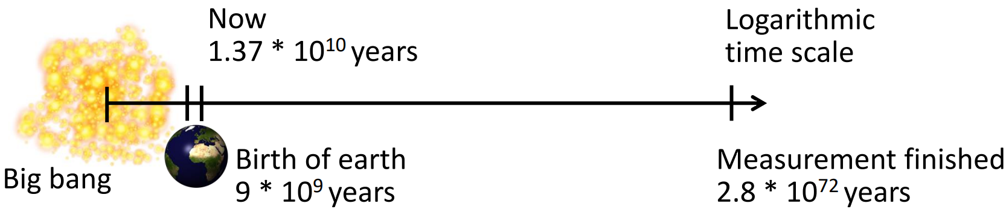
The Problem: Examples
Have a look at Berkley DB (C):
19 features
2560 configurations
426h (~18d) for brute force testing
Let’s go larger!
with SQLite!
77 features
3∙10⁷⁷ configurations
Assumption: 1 measurement = 5min (compilation + benchmark)
Notes:
Berkley DB ~ 10min per config.
Literally not doable for sqlite
Actual problem appears on this slide

Slide 6
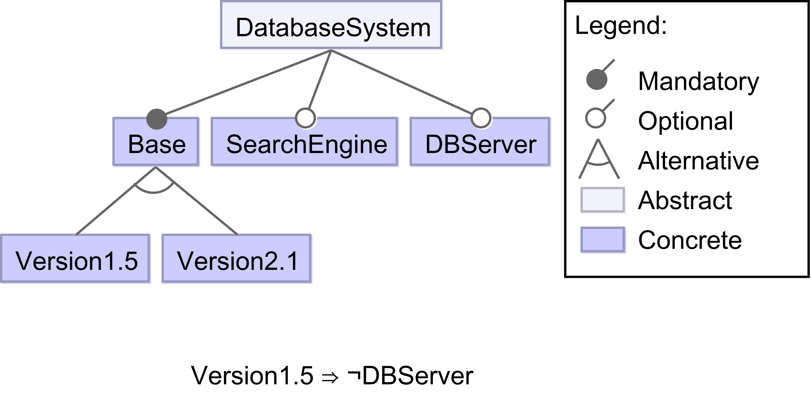
The Problem: Exponential Configuration Space
Presentation of valid configurations as Feature Model
⇔
Valid = Base ∧ (Version1.5 ⊕ Version2.1) ∧ (Version1.5 ⇒ ¬DBServer)
Example: Default = {Base = 1, Version2.1 = 1, SearchEngine = 0, DBServer = 0}
⇒ all valid configurations (Configuration Space) ∈ O(2^{#options})
Notes:
self explainatory feature model
Equivalent to a logical expression (with help of annotations)
How many valid assignments? => O(n^2)

Slide 7
Performance Learning and Prediction

Slide 8
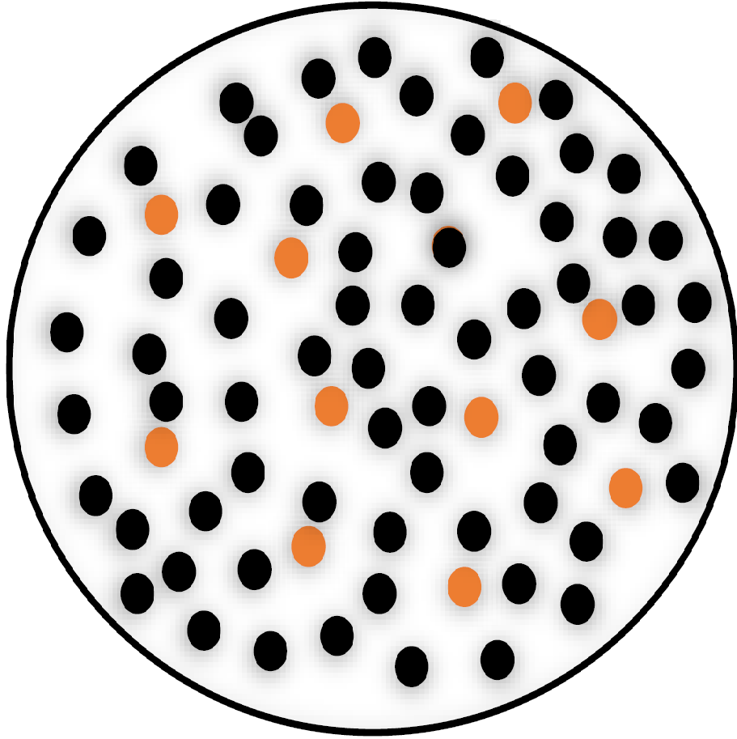
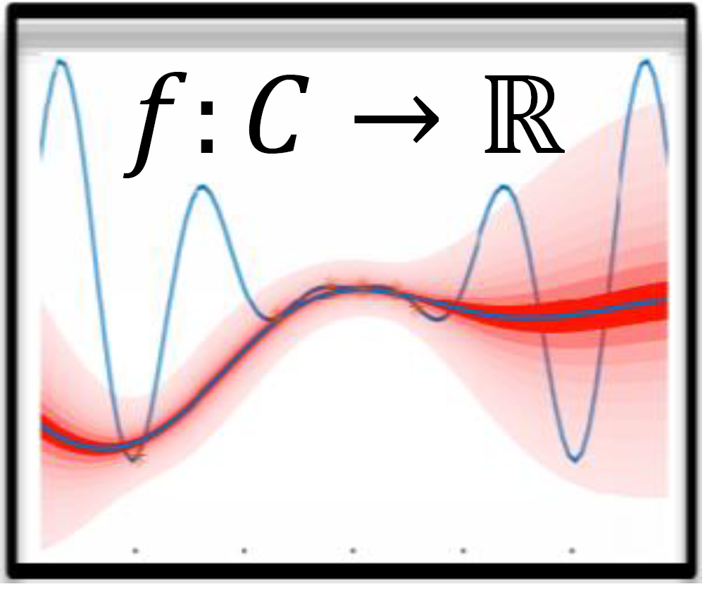
The General Approach
Sampling
Learning
Prediction
Optimization
Analysis
Presented Techniques:
Brute Force
Automated feature interaction detection
Projective Sampling
Notes:
General approach
Sampling -> reducing/filtering of the exponential configuration space (main problem)
Learning -> application of machine learning techniques
Brute force not feasible
AFID a non machine learning approach
Different sampling strategies

Slide 9
Automated Feature Interaction Detection
Goal: Assign a performance influence value ∏ to each feature (interaction).
A simplified example:
System S w/o features
∏(S) = 100
System S with a
∏(Sxa) = 110
System S with b
∏(Sxb) = 95
System S with a and b
∏(Sxaxb) = 103
∏(Sxa) = ∏(S) + ∏(a)
⇒ ∏(a) = 10
∏(b) = -5
∏(Sxaxb) = ∏(S) + ∏(a) + ∏(b) + ∏(a#b)
⇒ ∏(a#b) = -2
Notes:
b speeds up a aswell -> Sxaxb = 103 \= 105

Slide 10
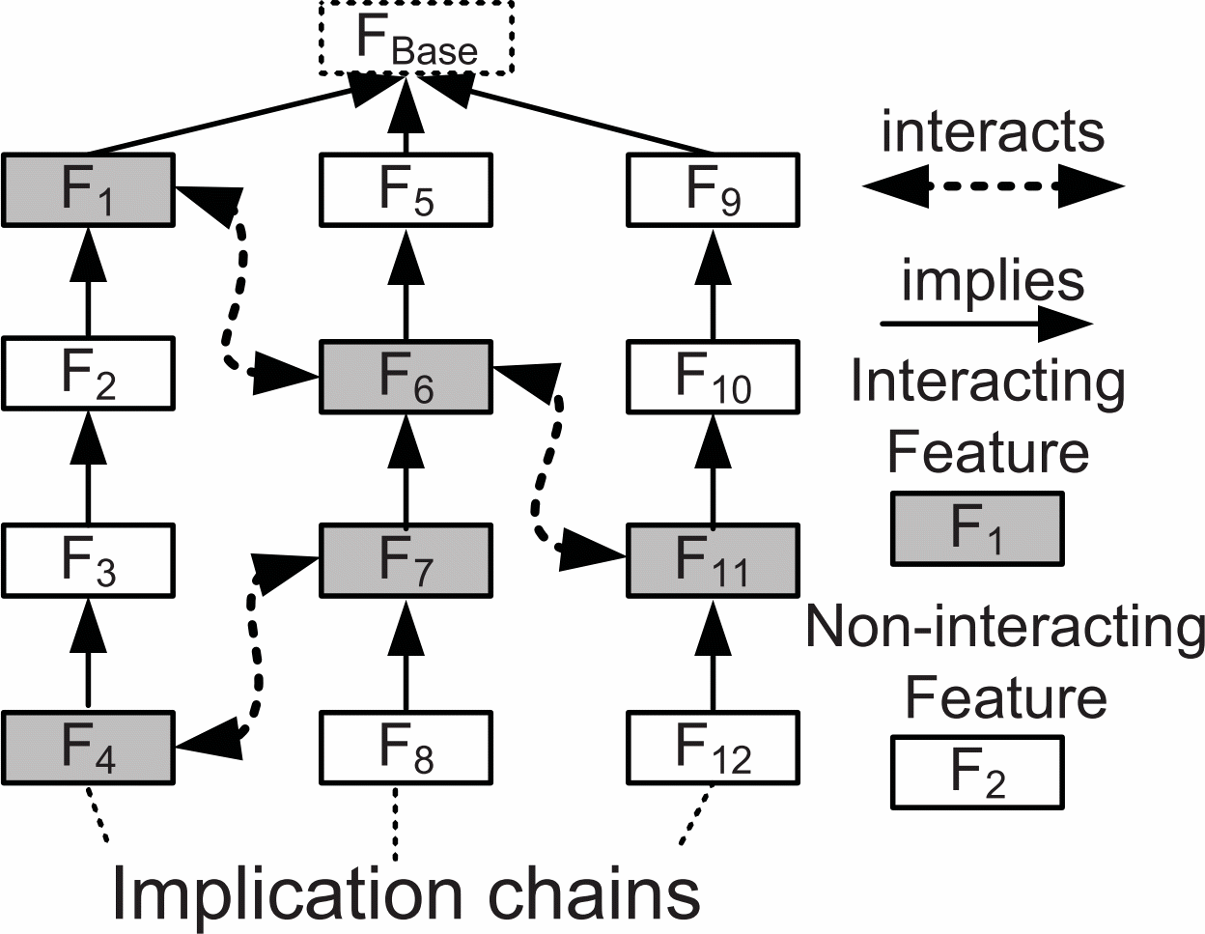
Automated Feature Interaction Detection Cont'd
Step 1: Find interacting features
for each feature f do…
∏(f)=∏(min(f)×f)-∏(min(f))
Measure and compute
∏(min(f)×f)
∏(max(f)×f)
yes
equal?
no
Mark f as interactive
Step 2: Measure feature interaction impact
Pair-Wise Heuristic
Measure Performance Impact
Higher-Order Heuristic
Isn’t this still factorial?
Hot-Spot Heuristic
O(n²) Pairs
Yes!
Notes:
Assign a performance influence value
2 steps:
Find interacting features
Measure interactions based on heuristics and implications chains

Slide 11


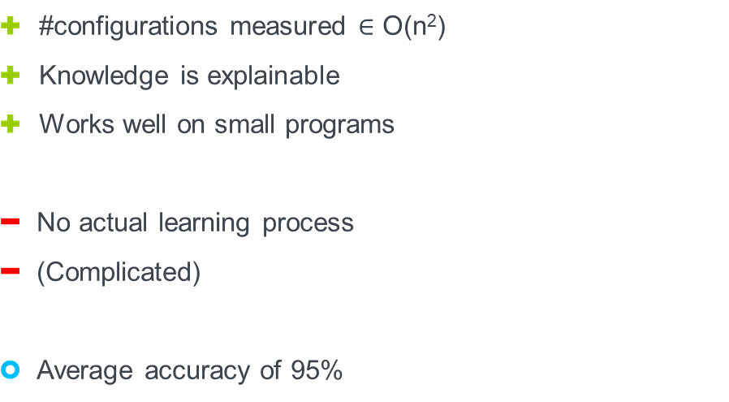

Automated Feature Interaction Detection
Advantages/Disadvantages
#configurations measured $∈$ O(n²)
Knowledge is explainable
Works well on small programs
No actual learning process
(Complicated)
Average accuracy of 95%

Slide 12
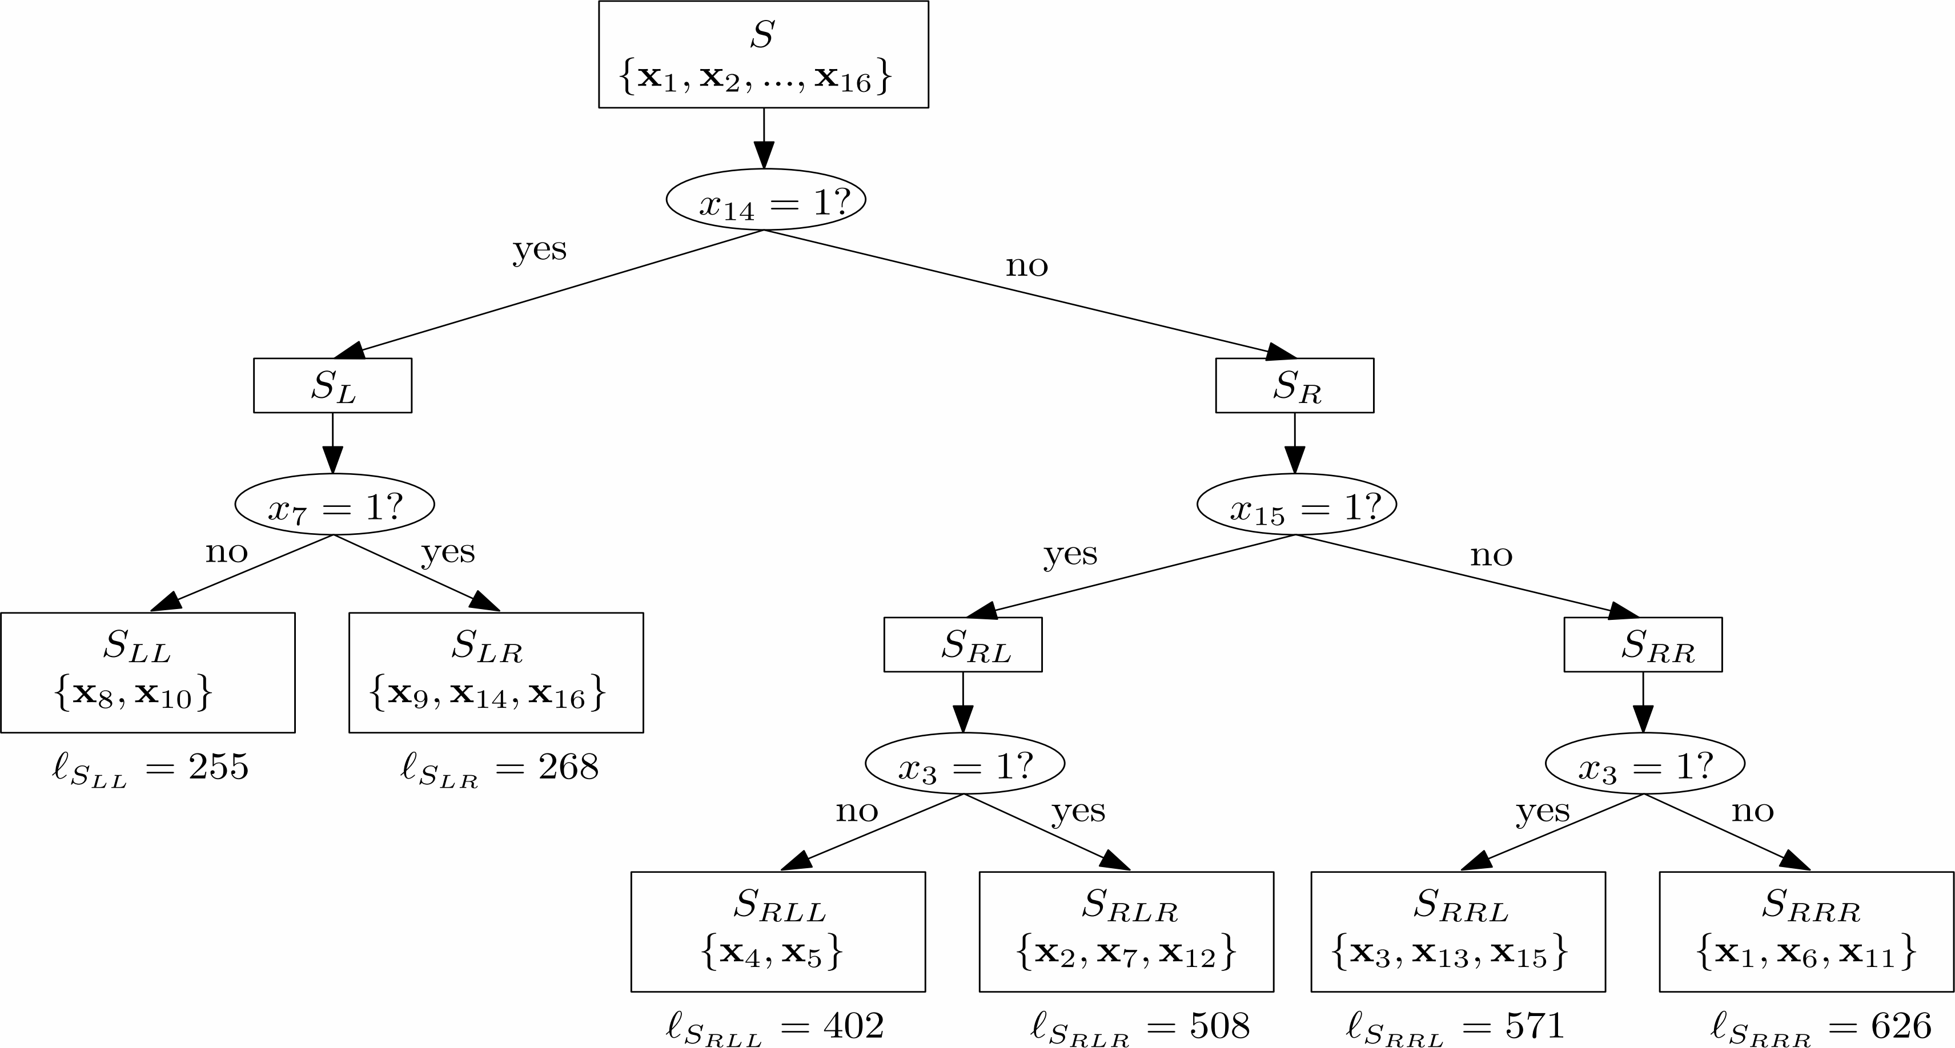
Classification and Regression Trees (CART)
Set of data points D + Evaluation Function + balancing Heuristic
Configurations are classified by thier performance values

Slide 13
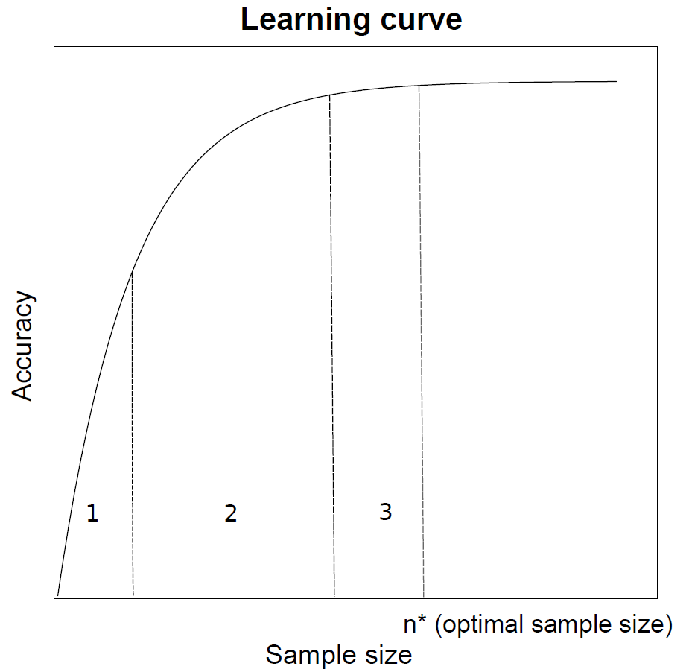
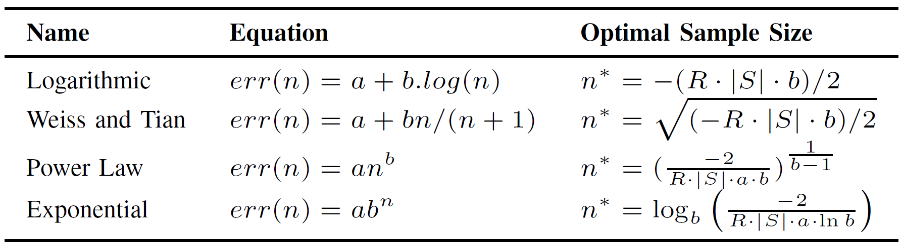
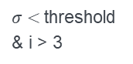


Projective Sampling
Tires to find an optimal sample size with curve fitting
iterative/randomized process
Function fitting
Substitute $err(n)$ with function and find minimum $=n^{∗}$
$σ<$threshold & i > 3
Start
i =1
Measure another random configurations
Insert into a Learning Algorithm
Evaluate mean error $σ$ of Predictor
Evaluate mean error 𝜎 of Predictor
Add point (i,1-$σ$) to learning curve
Add point (i,1-𝜎) to learning curve
i +=1
$$TotalCost\left(n\right)=2n+err(n)∙\left|S\right|∙R$$
Build CART
with an optimal
sized sample
Notes:
Takes advantage of knowledge on learning curves
Initial sample set is generated -> generates first part of learning curve
Curve fitting
Substitution and calculation of the optimal sample size

Slide 14
Progressive Sampling
Advantages/Disadvantages
also considers sampling cost
up to 99% accuracy
can use a significantly larger sample then other approaches
initial sample generation has high influence on accuracy

Slide 15
Other Sampling Techniques
Random Sampling
Chose random sample (no fixed size)
Whole sample is measured
Put Data into Learning Algorithm
Clustering based Sampling
Cluster Configurations (e.g. by distance)
Measure one Configuration of each leaf cluster
Put Data into Learning Algorithm
Progressive Sampling
Insert configurations stepwise into a Learning Process
Let this sample grow until the learning rate stagnates or the cost function reaches a minimum.

Slide 16
Conclusion
Main Problem: Reduction/Filtering of an exponential Configuration Space
Solved by using good sampling techniques
Learning with typical machine learning strategies
Sampling
Random
Projective
Learning
CART
Neural Network
Cluster Based
…
Transfer Learning
…
Prediction
Optimization
Analysis
A good balance between the sample size and accuracy is key
There is no perfect solution

